Slide 1
Discrete Mathematics and Logic (UE17CS205)
Unit 4 - Induction, Recursion and Recurrence Relations
Mr. Channa Bankapur (channabankapur@pes.edu)
Department of CS&E, PES University

Slide 2
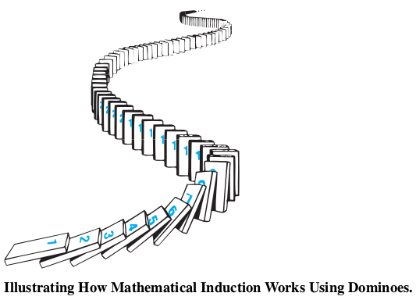
Mathematical Induction

Slide 3
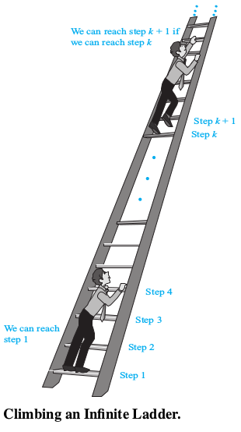
Mathematical Induction
Suppose that we have an infinite ladder and we want to know whether we can reach every step on this ladder. We know two things:
We can reach the first rung of the ladder.
If we can reach a particular rung of the ladder, then we can reach the next rung.
Can we conclude that we can reach every rung?

Slide 4
Mathematical Induction
By (1), we know that we can reach the first
rung of the ladder. By (2), we can also reach the
second rung because we can reach the first rung. Applying (2) again, we can also reach the third rung because we can reach the second rung. Continuing in this way, we can show that we can reach the fourth rung, the fifth rung, and so on. But can we conclude that we are able to reach every rung of this infinite ladder? The answer is yes, something we can verify using an important proof technique called mathematical induction.
That is, we can show that P(n) is true for every positive integer n, where P(n) is the statement that we can reach the n^{th} rung of the ladder.

Slide 5
Principle of Mathematical Induction:
To prove that P(n) is true for all positive integers n, where P(n) is a propositional function, we complete two steps:
Basis Step: We verify that P (1) is true.
Inductive Step: We show that the conditional statement P(k) → P(k+1) is true for all positive integers k.
Expressed as a rule of inference, this proof technique can be stated as
(P(1) ∧ ∀k (P(k) → P(k+1))) → ∀n P(n),
when the domain is the set of positive integers.

Slide 6
Why is mathematical induction a valid proof technique? The well-ordering property as an axiom for the set of +ve integers states that every nonempty subset of the set of +ve integers has a least element. So, suppose we know that P(1) is true and P(k) → P(k+1) is true for all +ve integers k. To show that P(n) must be true for all +ve integers n, assume that there is at least one +ve integer for which P(n) is false. Then the set S of +ve integers for which P(n) is false is nonempty. Thus, by the well-ordering property, S has a least element, which will be denoted by m. We know that m cannot be 1, because P(1) is true. Because m is +ve and greater than 1, m−1 is a +ve integer. Furthermore, because m−1 is less than m, it is not in S, so P (m−1) must be true. Because the conditional statement P(m−1) → P(m) is also true, it must be the case that P(m) is true. This contradicts the choice of m. Hence, P(n) must be true for every positive integer n.

Slide 7
Eg: Show that if n is a positive integer, then
1 + 2 + ··· + n = n(n+1)/2
Let P(n) be the proposition that the sum of the first n positive integers, 1 + 2 + · · · n = n(n+1)/2.
We must do two things to prove that P(n) is true.
Namely, we must show that P(1) is true and that the conditional statement P(k) implies P(k+1) is true for k = 1, 2, 3, … .
BASIS STEP: P (1) is true, because 1 = 1(1+1)/2.
INDUCTIVE STEP: For the inductive hypothesis we assume that P(k) holds for an arbitrary positive integer k. That is, we assume that 1 + 2 + ··· + k = k(k+1)/2.

Slide 8
Eg: Show that if n is a positive integer, then
1 + 2 + ··· + n = n(n+1)/2
…
Under this assumption, it must be shown that P(k+1) is true, namely, that
1 + 2 + · · · + k + (k + 1) = (k + 1)(k + 2)/2 is true.
When we add k + 1 to both sides of the equation in P(k), we obtain
1 + 2 + · · · + k + (k + 1) = k(k+1)/2 + (k + 1)
= (k(k+1)+(2k+2)) / 2
= (k+1)(k+2)/2
It shows that P(k+1) is true under the assumption that P(k) is true. This completes the inductive step.
So by mathematical induction we know that P(n) is true for all positive integers n.

Slide 9
Eg: Conjecture a formula for the sum of the first n positive odd integers. Then prove your conjecture using mathematical induction.

Slide 10
Eg: Conjecture a formula for the sum of the first n positive odd integers. Then prove your conjecture using mathematical induction.
Conjecture:
Sum of the first n positive odd integers is n².
1 + 3 + 5 + … + (2n-1) = n²

Slide 11
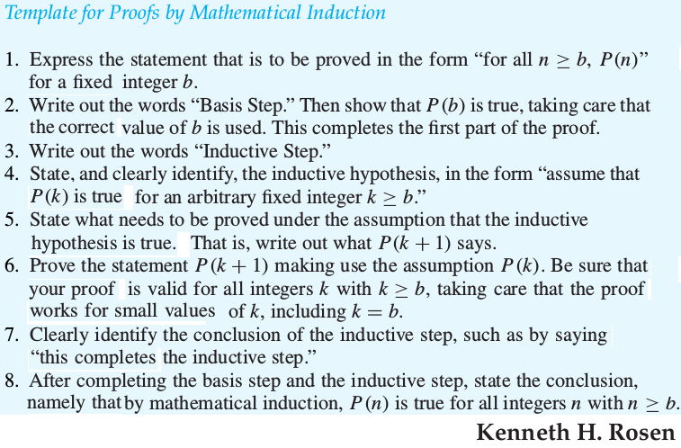

Slide 12
Eg: Use mathematical induction to show that
1 + 2 + 2² + · · · + 2^{n} = 2^{n+1} − 1
for all nonnegative integers n.

Slide 13

Eg: Sums of Geometric Progressions Use mathematical induction to prove this formula for the sum of a finite number of terms of a geometric progression with initial term a and common ratio r:
where n is a nonnegative integer.

Slide 14
Eg: Use mathematical induction to prove the inequality n < 2^{n} for all positive integers n.

Slide 15
Eg: Use mathematical induction to prove that 2^{n} < n! for every integer n with n ≥ 4. (Note that this inequality is false for n = 1, 2, and 3.)

Slide 16
Eg: Use mathematical induction to prove that n³−n is divisible by 3 whenever n is a positive integer.

Slide 17
Eg: Use mathematical induction to prove that 7^{n+2} + 8^{2n+1} is divisible by 57 for every nonnegative integer n.

Slide 18
Eg: The Number of Subsets of a Finite Set
Use mathematical induction to show that if S is a finite set with n elements, where n is a nonnegative integer, then S has 2^{n} subsets.

Slide 19
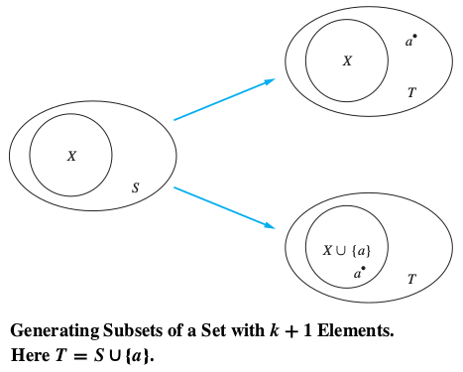
Eg: The Number of Subsets of a Finite Set
Use mathematical induction to show that if S is a finite set with n elements, where n is a nonnegative integer, then S has 2^{n} subsets.

Slide 20
[OPTIONAL] Eg: The input to a scheduling algorithm is a group of m proposed talks with preset starting and ending times. The goal is to schedule as many of these lectures as possible in the main lecture hall so that no two talks overlap. Suppose that talk t_{j} begins at time s_{j} and ends at time e_{j}. (No two lectures can proceed in the main lecture hall at the same time, but a lecture in this hall can begin at the same time another one ends.)

Slide 21
Eg: … scheduling algorithm …
Sort the talks in nondecreasing order of their ending times: e₁ ≤ e₂ ≤ … ≤ e_{m}.
The greedy algorithm starts by selecting a talk with the earliest end time and then proceeds by selecting at each stage a talk with the earliest ending time among all those talks that begin no sooner than when the last talk scheduled in the main lecture hall has ended. Using mathematical induction, show that this greedy algorithm is optimal in the sense that it always schedules the most talks possible in the main lecture hall.

Slide 22
Eg: … scheduling algorithm …
Let P(n) be the proposition that if the greedy algorithm schedules n talks in the main lecture hall, then it is not possible to schedule more than n talks
in this hall.
BASIS STEP: Suppose that the greedy algorithm managed to schedule just one talk, t₁ , in the main lecture hall. Every pair of talks are overlapping and hence only one talk can be scheduled.
INDUCTIVE STEP: The inductive hypothesis is that P(k) is true that the greedy algorithm always schedules the most possible talks when it selects k talks given any set of talks.

Slide 23
Eg: … scheduling algorithm …
We must show that P(k+1) follows from the assumption that P(k) is true, that is, we must show that under the assumption of P(k), the greedy algorithm always schedules the most possible talks when it selects k+1 talks.
Our first step in completing the inductive step is to show there is a schedule including the most talks possible that contains talk t1, a talk with the earliest end time. It’s easier to show t1 is in at least one of the schedules having k+1 talks, and it’s the first task in the schedule. A schedule that begins with the talk ti in the list, where i>1, can be changed so that talk t1 replaces talk ti. To see this, note that because e1≤ei, all talks that were scheduled to follow talk ti can still be scheduled.

Slide 24
Eg: … scheduling algorithm …
Once we included talk t1, scheduling the talks so that as many as possible are scheduled is reduced to scheduling as many talks as possible that begin at or after time e1. Because the greedy algorithm schedules k talks when it creates this schedule, we can apply the inductive hypothesis to conclude that it has scheduled the most possible talks. So P(k+1) is true.
So, by mathematical induction we know that P(n) is true for all positive integers n. That is, we have proved that when the greedy algorithm schedules n talks, when n is a positive integer, then it is not possible to schedule more than n talks.

Slide 25

[OPTIONAL] Eg: Let n be a positive integer. Show that every 2^{n} × 2^{n} checkerboard with one square removed can be tiled using right triominoes, where these pieces cover three squares at a time, as shown in the figure.
Solution: Let P(n) be the proposition that every 2^{n}×2^{n} checkerboard with one square removed can be tiled using right triominoes.
BASIS STEP: P(1) is true, because each of the four 2¹×2¹ checkerboards with one square removed can be tiled using one right triomino, as shown in the figure.

Slide 26
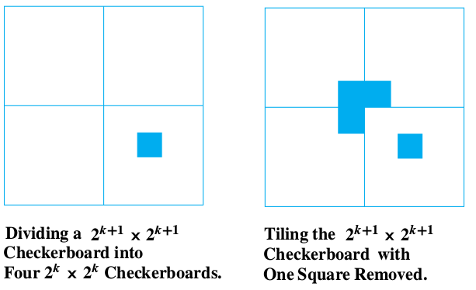

Slide 27
Strong Induction:
To prove that P(n) is true for all positive integers n, where P(n) is a propositional function, we complete two steps:
BASIS STEP:
We verify that the proposition P(1) is true.
INDUCTIVE STEP:
We show that the conditional statement
[P(1) ∧ P(2) ∧ · · · ∧ P(k)] → P(k+1)
is true for all positive integers k.

Slide 28
Note that when we use strong induction to prove that P(n) is true for all positive integers n, our inductive hypothesis is the assumption that P(j) is true for j = 1, 2, …, k. That is, the inductive hypothesis includes all k statements P(1), P(2), . . . , P(k). Because we can use all k statements P(1), P(2), . . . , P(k) to prove P(k+1), rather than just the statement P(k) as in a proof by mathematical induction, strong induction is a more flexible proof technique.
Mathematical induction and strong induction are equivalent. That is, each can be shown to be a valid proof technique assuming that the other is valid. In
particular, any proof using mathematical induction can also be considered to be a proof by strong induction.

Slide 29
Eg: Suppose we can reach the first and second rungs of an infinite ladder, and we know that if we can reach a rung, then we can reach two rungs higher. Prove that we can reach every rung using strong induction?
BASIS STEP: It simply verifies that we can reach the first two rungs.
INDUCTIVE STEP: The inductive hypothesis states that we can reach each of the first k rungs. We can complete the inductive step by noting that as long as k ≥ 2, we can reach the (k+1)^{st} rung from the (k−1)^{st} rung because we know we can climb two rungs from a rung we can already reach, and because k−1 ≤ k, by the inductive hypothesis we can reach the (k−1)^{st} rung. This completes the inductive step and finishes the proof by strong induction.

Slide 30
Eg: Show that if n is an integer greater than 1, then n can be written as the product of primes.
Let P(n) be the proposition that …
BASIS STEP: …
INDUCTIVE STEP: …

Slide 31
Eg: Show that if n is an integer greater than 1, then n can be written as the product of primes.
Let P(n) be the proposition that n can be written as the product of primes.
BASIS STEP: P(2) is true, because 2 can be written as the product of one prime, itself.
INDUCTIVE STEP: The inductive hypothesis is the assumption that P(j) is true for all integers j with 2≤j≤k. To complete the inductive step, it must be shown that P(k+1) is true under this assumption.
There are two cases to consider, namely, when k+1 is prime and when k+1 is composite.

Slide 32
If k+1 is prime, we immediately see that P(k+1) is true. Otherwise, k+1 is composite and can be written as the product of two positive integers a and b with 2 ≤ a ≤ b < k+1. Because both a and b are integers at least 2 and not exceeding k, we can use the inductive hypothesis to write both a and b as the product of primes. Thus, if k+1 is composite, it can be written as the product of primes, namely, those primes in the factorization of a and those in the factorization of b.

Slide 33
Eg: Consider a game in which two players take turns removing any positive number of matches they want from one of two piles of matches. The player who removes the last match wins the game. Show that if the two piles contain the same number of matches initially, the second player can always guarantee a win.
Solution: Let n be the number of matches in each pile, initially. Let P(n) be the propositional function that the second player can win when there are initially n matches in each pile.
BASIS STEP: …
INDUCTIVE STEP: …

Slide 34
Eg: Prove that every amount of postage of 12 cents or more can be formed using just 4-cent and 5-cent stamps.
Solution: Let P(n) be the propositional function that postage of n cents can be formed using 4-cent and 5-cent stamps.
BASIS STEP: …
INDUCTIVE STEP: …

Slide 35
Recursion is the process of defining an object in terms of itself.
Recursively Defined Functions
We use two steps to define a function with the set of nonnegative integers as its domain:
BASIS STEP: Specify the value of the function at zero.
RECURSIVE STEP: Give a rule for finding
its value at an integer from
its values at smaller integers.
Eg: Recursive definition of sum of first n natural numbers.
BASIS STEP: f(0) = 0.
RECURSIVE STEP: f(n) = f(n-1) + n.

Slide 36
Eg: Fibonacci numbers, f₀, f₁, f₂, . . . , are defined by
BASIS STEP: f₀ = 0, f₁ = 1.
RECURSIVE STEP: f_{n} = f_{n-1} + f_{n-2} .
Eg: Give a recursive definition of a^{n}, where a is a nonzero real number and n is a nonnegative integer.

Slide 37

Eg: Give a recursive definition of a^{n}, where a is a nonzero real number and n is a nonnegative integer.
BASIS STEP: a⁰ = 1.
RECURSIVE STEP: a^{n} = a * a^{n-1}.
Eg: Give a recursive definition of

Slide 38
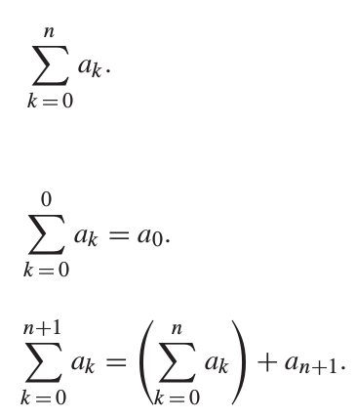
Eg: Give a recursive definition of
BASIS STEP:
RECURSIVE STEP:

Slide 39
Recursive algorithms
An algorithm is called recursive if it solves a problem by reducing it to an instance of the same problem with smaller input.
Eg: Give a recursive definition and recursive algorithm for computing n!, where n is a nonnegative integer.
Recursive definition: 0! = 1 and n! = n * (n-1)!
procedure factorial(n: nonnegative integer)
if n = 0 then return 1
else return n * factorial(n−1)

Slide 40
Eg: Give a recursive definition and a recursive algorithm for computing the greatest common divisor of two nonnegative integers a and b with b < a using Euclid’s method.
Recursive definition:
gcd(a, 0) = a, and
gcd(a, b) = gcd(b, a mod b)
procedure gcd(a, b: nonnegative integers
with b < a)
if b = 0 then return a
else return gcd(b, a mod b)

Slide 41
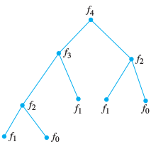
Eg: Give a recursive definition and a recursive algorithm for finding n^{th} number in the fibonacci sequence.
Recursive definition:
f(0) = 0, f(1) = 1, and
f(n) = f(n-1) + f(n-2).
procedure f(n: nonnegative
integer)
if n = 0 then return 0
else if n = 1 then return 1
else return f(n-1) + f(n-2)

Slide 42
Recurrence Relations
A recurrence relation for the sequence {a_{n}} is an equation that expresses a_{n} in terms of one or more of the previous terms of the sequence, namely, a_{n0}, a_{n1}, …, a_{n-1}, for all integers n with n ≥ n₀, where n₀ is a nonnegative integer.
A sequence is called a solution of a recurrence relation if its terms satisfy the recurrence relation.

Slide 43
Eg: Let {a_{n}} be a sequence that satisfies the recurrence relation a_{n} = a_{n-1} - a_{n-2} for n = 2, 3, …, and suppose that a₀ = 3 and a₁ = 5. What are a₂ and a₅?
Solution:
a₂ = 5 - 3 = 2
a₃ = 2 - 5 = -3
a₄ = -3 - 2 = -5
a₅ = -5 - (-3) = -2

Slide 44
Eg: Determine whether the sequence {a_{n}}, where a_{n} = 3n for every nonnegative integer n, is a solution of the recurrence relation a_{n} = 2a_{n-1} - a_{n-2} for n = 2, 3, 4, …. Answer the same question where
(b) a_{n} = 2^{n} and
(c) a_{n} = 5.
Solution: True because 2(3(n-1))-3(n-2) = 3n
(b) False because 2(2^{n-1})-2^{n-2} = 2^{n} is false.
(c) True because 2(5) - 5 = 5.

Slide 45
Fibonacci numbers:
f_{n} = f_{n-1} + f_{n-2}, where f₀ = 0 and f₁ = 1.
Eg: Find a recurrence relation and give initial conditions for the number of bit strings of length n that do not have two consecutive 0s. How many such bit strings are there of length eight.
Solution: …

Slide 46
Eg: Find a recurrence relation and give initial conditions for the number of bit strings of length n that do not have two consecutive 0s. How many such bit strings are there of length eight.
Solution: a_{n} = a_{n-1} + a_{n-2}, where a₁ = 2 and a₂ = 3.
2, 3, 5, 8, 13, 21, 34, 55.
55 bit strings of length 8 don’t have 2 consecutive 0s.

Slide 47
The Tower of Hanoi puzzle:
Move n disks from peg A to peg B using peg C.
Move top n-1 disk from peg A to C.
Move disk# n from peg A to B.
Move n-1 disks from peg C to B
# of moves, H_{n}=2H_{n-1}+1 with the initial condition H₁=1.
Power(x, y) = x * Power(x, y-1), where x∈R, y∈Z⁺
with the initial condition Power(x, 0) = 1.
Factorial(n) = n * Factorial(n-1), where n∈Z⁺ and Factorial(0) = 1.

Slide 48
Eg: Suppose that a person deposits Rs. 10,000 in a savings account at a bank yielding 11% per annum with interest compounded annually. How much will be in the account after 30 years?
P_{n} = 1.11 * P_{n-1}, P₀ = ₹10,000
P₃₀ = ₹228,922

Slide 49
Solving Recurrence Relations
Finding solution to a recurrence relation means finding “closed form expressions” equivalent to the recurrence because it is as good as generating the sequence and find n^{th} term directly without finding the previous terms.
Q: Solve a_{n} = a_{n-1} + C, where a₀ is a constant
Solution: a_{n} = C*n + a₀
Q: Solve a_{n} = Ca_{n-1}, where a₀ is a constant
Solution: a_{n} = C^{n} * a₀

Slide 50
Solving Linear Homogeneous Recurrence Relations with Constant Coefficients
Linear homogeneous recurrence relation of degree k with constant coefficients is a recurrence relation of the form:
a_{n} = c₁a_{n-1} + c₂a_{n-2} + ... + c_{k}a_{n-k}
where c₁, c₂, c₃, ..., c_{k} are reals and c_{k} ≠ 0.

Slide 51
Linear Homogeneous Recurrence Relations with Constant Coefficients
a_{n} = c₁a_{n-1} + c₂a_{n-2} + ... + c_{k}a_{n-k}
a_{n} = 2a_{n-1} + 3 is not homogeneous (not all terms has a factor a_{j})
a_{n} = na_{n-1} coefficient not constant
a_{n} = 3a²_{n-1} is not linear
a_{n} = a_{n-1} + a_{n-2} is of degree 2
a_{n} = 4a_{n-2} is of degree 2
a_{n} = 3a_{n-5} - 4a_{n-2} is of degree 5

Slide 52
Linear Homogenous Recurrence Relation with constant coefficients occur often in modeling problems and can be systematically solved.
Theorem 1 - For degree 2 and distinct roots r₁ and r₂
{a_{n}} is a solution of a_{n} = c₁a_{n-1} + c₂a_{n-2}
iff a_{n} = α₁r₁^{n} + α₂r₂^{n} for n = 0, 1, 2, ...,
where r² - c₁r - c₂ = 0 has two distinct roots r₁ and r₂,
with constants α₁ and α₂.

Slide 53
Theorem 1: {a_{n}} is a solution of a_{n} = c₁a_{n-1} + c₂a_{n-2}
iff a_{n} = α₁r₁^{n} + α₂r₂^{n} for n = 0, 1, 2, ...,
where r² - c₁r - c₂ = 0 has two distinct roots r₁ and r₂,
with constants α₁ and α₂
Recurrence: a_{n} = c₁a_{n-1} + c₂a_{n-2}
Characteristic equation: r² - c₁r - c₂ = 0
Characteristic roots: r₁ and r₂ (distinct roots)
Solution for the recurrence: a_{n} = α₁r₁^{n} + α₂r₂^{n} for n = 0,1,2,...,
Constants: α₁ and α₁ are constants, which can be
found using initial conditions a₀ and a₁.

Slide 54
Q: What is the solution (closed form) of
a_{n} = a_{n-1}+ 2a_{n-2} where a₀ = 2, a₁ = 7
Soln: c₁= 1, c₂ = 2
r² - c₁r - c₂ = 0 is the characteristic equation
r² - r - 2 = (r+1)(r-2) = 0
r₁ = 2, r₂ = -1 are the characteristic roots
Using initial conditions and roots, solve
a_{n} = α₁r₁^{n} + α₂r₂^{n} for α₁ and α₂
a_{n} = α₁2^{n} + α₂(-1)^{n}

Slide 55
a_{n} = α₁2^{n} + α₂(-1)^{n}
for constants α₁ and α₂
a₀ = 2
= α₁r₁⁰ + α₂r₂⁰
= α₁2⁰ + α₂(-1)⁰
= α₁ + α₂
α₁ + α₂ = 2
a₁ = 7
= α₁r₁¹ + α₂r₂¹
= α₁2¹ + α₂(-1)¹
= 2α₁ - α₂
2α₁ - α₂ = 7

Slide 56
Solving simultaneous equations
α₁ + α₂ = 2
2α₁ - α₂ = 7
α₁ =3, α₂ = -1
a_{n} = α₁2^{n} + α₂(-1)^{n}
a_{n} = 3*2^{n} + (-1)^{n+1}
is the solution (closed form) for
a_{n} = a_{n-1}+ 2a_{n-2} where a₀ = 2, a₁ = 7

Slide 57
Q: Find the solution (closed form) of a_{n} = 7a_{n-1} - 10a_{n-2}
where a₀ = 2, a₁ = 1
Soln: …

Slide 58
Q: Find the solution (closed form) of f_{n} = f_{n-1} + f_{n-2}
where f₀ = 0, f₁ = 1
Soln: …

Slide 59
Q: Find the solution (closed form) of a_{n} = 2a_{n-1}
where a₀ = 3
Soln: …

Slide 60
Q: Find the solution (closed form) of a_{n} = 2a_{n-1}
where a₀ = 3
Soln: This is a known form.
The solution of a_{n} = Ca_{n-1} would be a₀ * C^{n}
Therefore, solution of a_{n} = 2a_{n-1} is 3 * 2^{n}
Alternate Soln: By substitution.

Slide 61
Q: Find the solution (closed form) of a_{n} = 2a_{n-1}
where a₀ = 3
Soln: By substitution
a_{n} = 2a_{n-1} where a₀ = 3
a_{n} = 2a_{n-1}
= 2(2a_{n-2}) = 2²a_{n-2}
= 2²(2a_{n-3}) = 2³a_{n-3}
= 2^{i} a_{n-i}
When n-i=0, i=n
= 2^{n} a₀
= 3*2^{n}

Slide 62
Q: What is the solution (closed form) of
a_{n} = 6a_{n-1}- 9a_{n-2} where a₀ = 1, a₁ = 6
Soln: c₁= 6, c₂ = -9
r² - 6r + 9 = (r-3)(r-3) = 0
r₁ = 3, r₂ = 3
but the roots are not distinct…

Slide 63
Theorem 2 - For degree 2 and 1 root (multiplicity 2)
{a_{n}} is a solution of a_{n} = c₁a_{n-1} + c₂a_{n-2}
iff a_{n} = α₁r₀^{n} + α₂nr₀^{n} for n=0,1,2,...,
where r² - c₁r - c₂ = 0 has one root r₀,
with constants α₁ and α₂.

Slide 64
Q: What is the solution (closed form) of
a_{n} = 6a_{n-1}- 9a_{n-2} where a₀ = 1, a₁ = 6
Soln: c₁= 6, c₂ = -9
r² - 6r + 9 = (r-3)(r-3) = 0
r₀ = 3
a_{n} = α₁r₀^{n} + α₂nr₀^{n} = α₁3^{n} + α₂n3^{n}
for constants α₁ and α₂
a_{n} = α₁r₀^{n} + α₂nr₀^{n}
= α₁3^{n} + α₂n3^{n}
a_{n} = 3^{n} + n3^{n}

Slide 65
Theorem 3 - For degree k and distinct roots
{a_{n}} is a solution of a_{n} = c₁a_{n-1} + c₂a_{n-2}+ .. +c_{k}a_{n-k}
iff a_{n} = α₁r₁^{n} + α₂r₂^{n} + .. + α_{k}r_{k}^{n} for n=0, 1, 2, ...,
where r^{k} - c₁r^{k-1} - .. - c_{k} = 0 has k distinct roots
r_{1,} r_{2,} .. r_{k}, with constants α₁, α₂, .. , α_{k}

Slide 66
Q: What is the solution (closed form) of
a_{n} = 6a_{n-1}- 11a_{n-2} + 6a_{n-3} where a₀ = 2, a₁ = 5, a₂ = 15
Soln: …

Slide 67
Theorem 4 - For degree k with some non-distinct roots
Let c₁, c₂, …, c_{k} be real numbers. Suppose that the characteristic equation r^{k} - c₁r^{k-1} - … - c_{k} = 0 has t distinct roots r_{1,} r_{2,} ... r_{t} with multiplicities m_{1,} m_{2,} ... m_{t} , respectively, so that m_{i} ≥ 1 for i = 1, 2, …, t and m₁ + m₂ + ... m_{t} = k. Then a sequence {a_{n}} is a solution of the recurrence relation a_{n} = c₁a_{n-1} + c₂a_{n-2}+ … + c_{k}a_{n-k} iff
a_{n} = (α_{1,0}+ α_{1,1} n¹ + … + α_{1,m1 - 1} n^{m1 - 1} )r₁^{n}
+ (α_{2,0}+ α_{2,1} n¹ + … + α_{2,m2 - 1} n^{m2 - 1} )r₂^{n}
+ … + (α_{t,0}+ α_{t,1} n¹ + … + α_{t,mt - 1} n^{mt - 1} )r_{t}^{n} for n=0, 1, 2, ...,
where α_{i, j} are constants 1 ≤ i ≤ t, 0 ≤ j ≤ m_{i} - 1.

Slide 68
Suppose that the roots of the characteristic equation of a linear homogeneous recurrence relation are 2, 2, 2, 5, 5, and 9. The form of the general solution would be:
a_{n} = (𝝰_{1,0} +𝝰_{1,1} n +𝝰_{1,2} n²) 2^{n} +
(𝝰_{2,0} +𝝰_{2,1} n) 5^{n} +
𝝰_{3,0} 9^{n}.

Slide 69
Q: What is the solution (closed form) of
a_{n} = -3a_{n-1}- 3a_{n-2} - a_{n-3} where a₀ = 1, a₁ = -2, a₂ = -1
Soln: …

Slide 70
Eg: How many bit strings of length n are there that
do not contain two consecutive 0s?
Eg: How many bit strings of length n are there that contain two consecutive 0s?
Eg: How many bit strings of length n are there that
contain three consecutive 0s?

Slide 71
Eg: How many bit strings of length n are there that
do not contain two consecutive 0s?
There are only two possibilities; n^{th} bit is 0 or 1.
f(n) = the case where n^{th} bit 1 + the case where n^{th} bit is 0
When n^{th} bit is 1, there are f(n-1) bit strings.
When n^{th} bit is 0, (n-1)^{th} bit has to be 1, and hence there are f(n-2) bit strings.
∴ f(n)= f(n-1) + f(n-2), where f(1) = 2 and f(2) = 3.

Slide 72
Q: Given infinite number of red and blue balls, how many ways are there to arrange n balls such that no two red balls are adjacent?
OR How many bit strings of length n are there that
do not contain two consecutive 0s?
To find f(n).
n^{th} ball is blue or red.
If n^{th} ball is blue, the count is f(n-1).
If n^{th} ball is red, (n-1)^{th} ball has to be blue, and hence the count is f(n-2).
∴ f(n) = f(n-1) + f(n-2), f(1) = 2, f(2) = 3.

Slide 73
Eg: How many bit strings of length n are there that
contain two consecutive 0s?
To find f(n).
When last bit is 1, there are f(n-1) bit strings.
When last two bits are 01, there are f(n-2) bit strings.
When last two bits are 00, there are 2^{n-2} bit strings.
∴ f(n)= f(n-1) + f(n-2) + 2^{n-2}, where f(1) = 0 and f(2) = 1.
Also, f(n) = 2^{n} - f(n-1) - f(n-2)
2^{n} - 2^{n-2} = 2f(n-1) + 2f(n-2)
(3/2)2^{n-2} = f(n-1) + f(n-2) = “do not contain 2 consec. 0s.”

Slide 74
Eg: How many bit strings of length n are there that
contain three consecutive 0s?
To find f(n).
When 1st bit is 1, there are f(n-1) bit strings.
When 1st two bits are 01, there are f(n-2) bit strings.
When 1st three bits are 001, there are f(n-3) bit strings.
When 1st three bits are 000, there are 2^{n-3} bit strings.
∴f(n)=f(n-1)+f(n-2)+f(n-3)+ 2^{n-3},where f(1)=f(2)=0 & f(3)=1.

Slide 75
< End of
Mathematical Induction,
Recursion and Recurrence Relations
/>

